Slide 1
DIRECTORS & OFFICERS LIABILITY INSURANCE/LABOR ORGANIZATION BOND
December 2024
Notes:
There are two title slide options: One without photos (here)

Slide 2
Karen L. Feger, Account Executive
Schoenfeld Insurance Assoc.
Karen’s 40 year career in the insurance industry is highlighted by her work as an Account Manager on high profile global business accounts and mentoring younger production staff members.
She has earned and maintains the following professional designations with annual continuing education courses: Certified Insurance Counselor (1998) and Certified Risk Manager (2010)
Notes:
You may want to highlight an image – and use the picture to tell a story. The next slides allow you to do that, using elements from the IAFF Brand.

Slide 3
Directors & Officers Employment Practices Personal Injury

Slide 4
General Liability vs Union Liability What Triggers coverage?

Slide 5
Reasons Officers are sued
Breach of fiduciary duty resulting in financial losses
Misrepresentation of company assets
Misuse of company funds
Failure to comply with workplace laws
Lack of governance

Slide 6
WHY do my Officers need this Coverage?
Any allegations of wrongdoing by an Officer will result in legal expenses and defense fees.
Protect Union’s assets
Protect Officer’s assets
Group Purchasing Program saves MONEY!

Slide 7
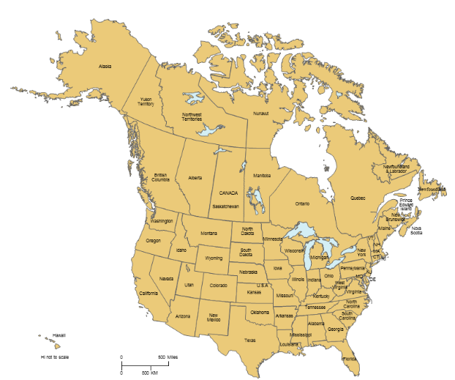
WHERE is this Available?
Shared Aggregate Policy
All states except CO, IL, WI – State leadership control policies for their members
Available in Canada (Application must be sent to smcmullin@iaff-fc.com)
Stand-Alone Policy
All states
Pending in Canada - new contract w/Canadian broker is imminent

Slide 8
WHO is covered?
Any person performing services on behalf of or at the direction and authority of the Union.
Insured Persons
Past, Present, Future Officers
Trustees
E Board Members
Committee Members
Shop Steward
Business Agent/Volunteer

Slide 9
WHAT is Covered by the Policy?
Wrongful Acts
Wrongful Employment Practices
Personal Injury
Financial Mismanagement
Harassment
Discrimination
Retaliation
Wrongful Discipline
Wrongful Termination
Denial of fair access to Members Benefits
Mishandling Grievance
Union Election Conduct
Discipline/Expulsion of Union Member
Denial of union Membership
Failure to provide fair representation

Slide 10
How does a shared-aggregate policy work?
$2,000,000 Policy Aggregate
Local 1 - $1,000,000 Limit per Claim
Local 2 - $250,000 Limit per Claim
Local 3 - $25,0000 Limit per Claim
Local 5 - $500,000 Limit per Claim
Local 4 - $500,000 Limit per Claim
Local 6 - $250,000 Limit per Claim

Slide 11
Important Policy Features
Coverage is provided by Markel American Insurance Company
Policy is non-cancellable during the policy term except for non-payment of premium;
Union may choose their own legal counsel.
Available Limits: $250,000; $500,000; $1,000,000

Slide 12
Program Enhancements
- UL-043 Investigatory Expense Sub-Limit of $10,000 (this coverage will provide defense if a governmental agency requests documents, interviews etc. prior to an allegation of wrongdoing. The regular limit kicks in once you are accused of wrongdoing.)
- UL-051 Modification Endorsement (modified to automatically include PACs of a certain size and Real Estate Holding Companies.)
- UL-053a Broadened Capacity Endorsement with Insured Services (provides coverage for the State entity for suits by the Locals or other IAFF entities for not fulfilling their obligations. The language to be included on the endorsement is as follows: Collective bargaining or Fair Representation services performed by the Insured on behalf of contracted local affiliates and/or their members. (Available for State or Provincial entities only, based on contractual need.)

Slide 13
Individual Labor Leader Protection
Title V of the Landrum Griffin Act, aka the Labor Management Reporting and Disclosure Act (LMRDA) generally provides that it is against public policy to relieve union officers of liability for certain breaches of duty, such as personal profit, fraud or conflict of interest. Thus, labor leaders can be personally responsible for all defense costs. The Individual Labor Leader endorsement to the Union Liability policy pays defense costs for allegations like these, subject to terms, conditions & exclusions of the policy.
Includes coverage for claims arising from LM-30 reporting violations.
Limit: | Annual Aggregate Limit for any and all loss under this optional coverage: | Annual Premium per Participant – fully earned:
$ 25,000 | $250,000 | $25.00
$ 50,000 | $250,000 | $50,00
$ 75,000 | $250,000 | $75.00
$100,000 | $250,000 | $100.00
$200,000 | $450,000 | $125.00
$250,000 | $450,000 | $150.00

Slide 14
Cost for the shared-aggregate format
COMPONENTS OF PREMIUM CALCULATION
# of Officers or Voting Board Members
# of Employees (of the Union not the Department) / Non-Board Members
Annual Revenue (Dues income only)
Average cost for $250,000 limit is between $828 and $933 per year; and about $1,297 per year for a $500,000 limit.
A firm quote will be provided upon receipt, review of application and confirmation of eligibility criteria.
SAVE
50%

Slide 15
REVENUE | $250,000 Limit (aggregate/costs inclusive) w/ $5,000 Deductible
 | Up to 5 Officers | 6-7 Officers | 8 or more
Up to $80,500 | $828 | $933 | TBD
$80,501-$149,999 | $1,087 | $1,175 | TBD
REVENUE | $500,000 Limit (aggregate/costs inclusive) w/ $5,000 Deductible
 | Up to 7 Officers | 8 or more
Up to $180,000 | $1,297 | TBD
$180,001-$320,000 | $1,572 | TBD
$320,001-$499,999 | $1,974 | TBD
Rates indicated above are approximate and do not apply to Locals that have more than one employee (does not apply to shift reimbursements.) A firm quote will be provided upon receipt and review of this application and confirmation of the eligibility criteria listed below.

Slide 16
Claims
Breach of Duty of Fair Representation – COVID-related. Potential claim over Religious Exemption to Employer’s Vaccine Mandate;
Investigatory Expense only – Grand Jury Subpoena; ($5,000)
Defamation – Plaintiff alleges that Union President made defamatory comments about his business; (just under $5,000, still in deposition stage);
Breach of Duty of Fair Representation –Claimant alleges that his Union failed/refused to escalate a filed grievance to arbitration;

Slide 17
CLAIMS continued
5. Disability Discrimination – plaintiff suffered a heart attack and was
cleared to return to work. Alleges the Union representative
colluded with his employer to stop his return to work; (open reserve
for $100,000);
Race Discrimination – Plaintiff alleges that his Union and its President discriminated against him on the basis of race, retaliated against him, and wrongfully terminated minority employees and members; ($44,000)
Age Discrimination – Plaintiff sued the Union over allegations of wrongful termination due to his age; ($80,000)

Slide 18
CLAIMS continued
Breach of Contract – Plaintiff filed a declaratory action against his Union seeking an accounting of funds placed into a health trust;
Breach of the Duty of Fair Representation – Plaintiff filed a labor relations complaint against his Union for engaging in unfair labor practices by conspiring with his employer to prevent him from receiving line-of-duty pension benefits. ($190,000)

Slide 19
Claims Costs
$1,000
$75,000
$76,000
Settlement Amount
Legal Fees
Total Cost of Claim

Slide 20
Group Purchasing Program saves money!
WHO
IAFF Affiliate Locals
WHAT
A limit of Directors & Officers Liability and Employment Practices Covg.
WHERE
USA and Canada
WHY
Added member benefit
Affordable price
Simple application and Underwriting process
WHEN
NOW!
IAFF Affiliate Locals

Slide 21
Labor Organization Bond Fidelity Coverage

Slide 22
Union Liability vs. Fidelity Bond
Directors & Officers Liability
Labor Organization Bond
Covers: Entity and Individual Officers for wrongful acts;
Defense costs, Investigatory Expenses & jury awards;
Legal: Can select your own counsel
Limits: available at $250,000, $500,000 and $1,000,000 w/$5,000 deductible;
Program term: Annual 4/1 anniv.
Covers: Individual Officers & Employees for Faithful Performance;
Reimbursement of Lost Funds & some audit expenses;
Legal: May require prosecution
Limits: First $5,000 provided by IAFF, increased limits available up to $500,000 at Local’s cost;
3-Year Term: 4/1/23-26

Slide 23
Union Liability vs. Fidelity Bond
Directors & Officers Liability
Labor Organization Bond
Policy between the individual and Schoenfeld/Markel
Program under the IAFF FC
Policy between the IAFF and Schoenfeld/Zurich
First $5,000 provided by IAFF, increased limits available up to $500,000 at Local’s cost
Article VI, Section 6 of the IAFF Constitution and By-Laws makes it clear that bonding of affiliates is under the purview of the General Secretary-Treasurer and the Board of Trustees.

Slide 24
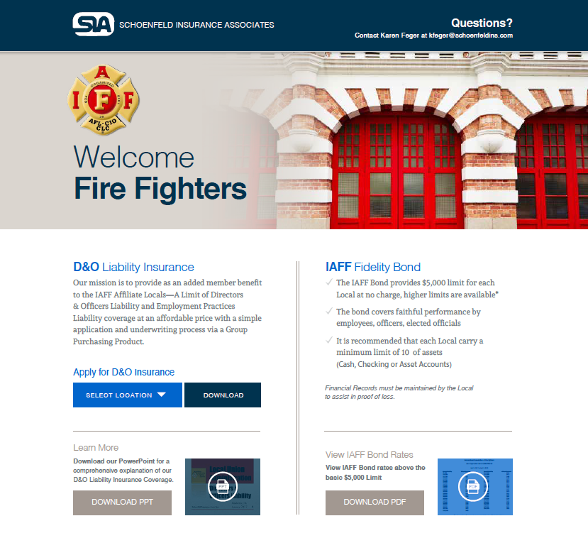
Learn More
Contact
Questions/US Applications
Karen Feger
kfeger@schoenfeldins.com
Canadian Applications Only
Sara McMullin
smcmullin@iaff-fc.com
Schoenfeld Insurance Assoc. Inc.
6225 Smith Ave
Baltimore, MD 21209
www.schoenfeldins.com/iaff
1-888-519-7575
www.schoenfeldins.com/iaff
www.iaff-fc.com

Slide 25
THANK YOU! ANY QUESTIONS?
Karen . Feger, CIC, CRM
Schoenfeld Insurance Assoc.
kfeger@schoenfeldins.com
Notes:
Keeping the photo? Right-click on the image, select “Change Picture,” find your file, and place the image. If you need to reposition the face to be centered, use the “crop” tool in the “Photo Format” menu. Contact Communications Division or Education Department for assistance.

